Slide 2
Objectives
Explain the purpose and need for data compression
Understand that compression reduces the size of a file
Understand the impact of compression, including:
Less bandwidth required
Less storage space required
Shorter transmission time
Understand how files are compressed using lossy and lossless compression methods
Explain how data can be compressed using run length encoding (RLE) using frequency/data pairs
Understand how reducing resolution, colour depth or sample rate results in data being permanently removed

Slide 3
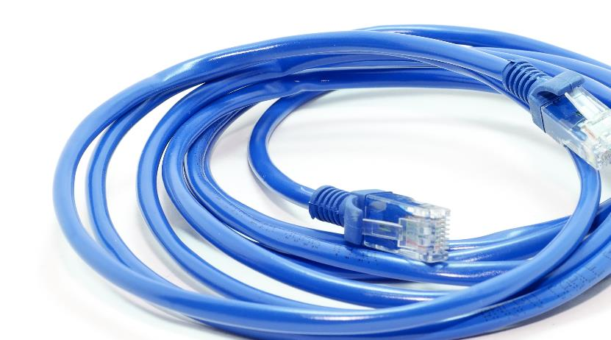

Starter
HD TV has a resolution of 1920px × 1080px
This results in 2.1 megapixels per frame
Each pixel uses 24-bit colour
This means each frame needs about 50 megabits
There are 25 frames per second resulting in a total amount of data being 1.25 gigabits per second
How can we possibly stream this through internet connections that are typically under 70 Mb/s in the UK?

Slide 4
Compression techniques
Compression is the name given to algorithms which reduce file sizes
Decompression is the process where compressed data is restored to its original format
Compression is heavily used with sound, image and video files
There are two types of compression:
Lossy compression (JPG, GIF, MP3)
Lossless compression (PNG, TIFF)

Slide 5
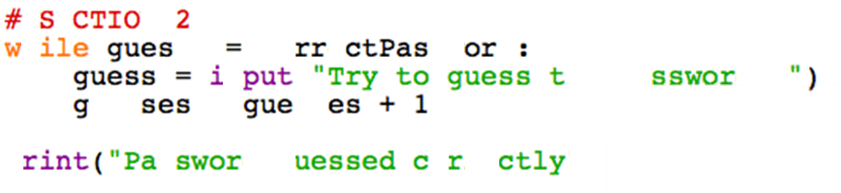
Lossy compression
Lossy compression permanently loses some data
Would a lossy compression algorithm work for compressing a computer program?

Slide 6
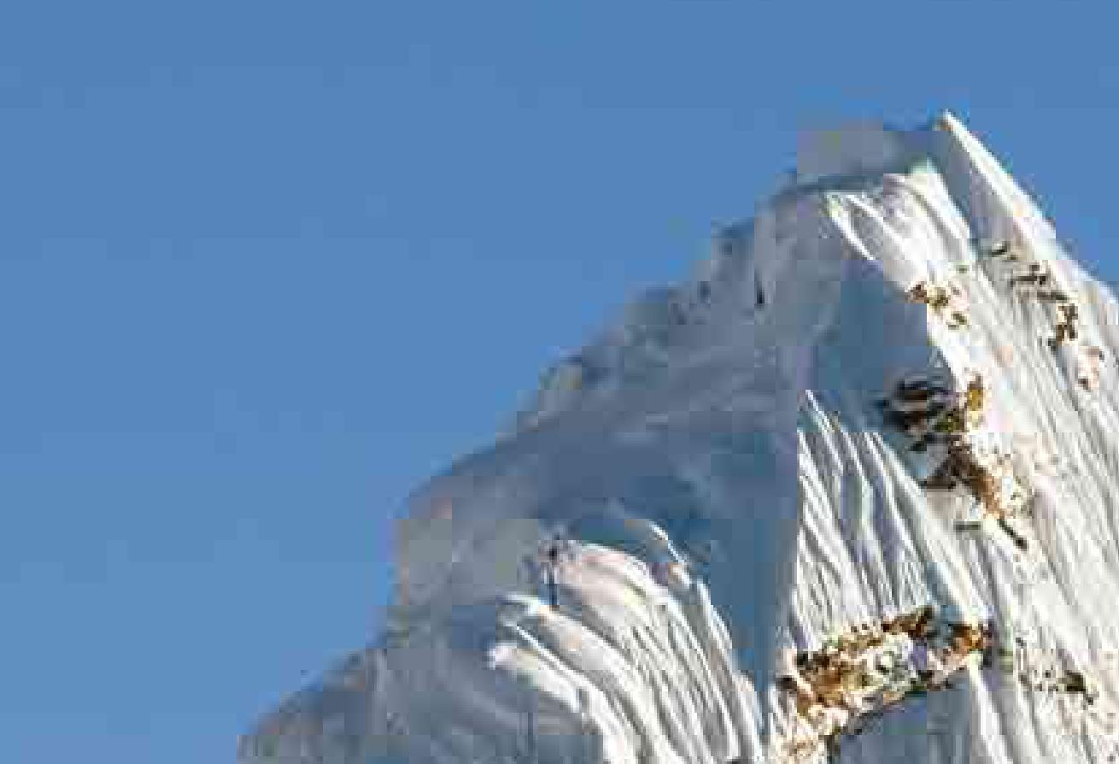

Lossy compression artefacts
Lossy compression results in small mistakes known as ‘digital artefacts’ appearing in images and video
Noise can often be seen where there are contrasting colours
Blocks can often result from lossy compression

Slide 7
Lossless image compression
Lossless image compression will not lose any of the original data
The algorithm finds groups of repeating data and records the data once, along with the number of repetitions
= 12 × , 6 ×
When data is uncompressed it is restored exactly as it was in the original
Which image file format uses this technique?

Slide 8
Run Length Encoding
RLE uses frequency/data pairs to encode each run length of the same coloured pixel
Assuming 1 = white and black = 0, this run could be encoded as:
1111000000000000
Using RLE, the row could be represented as 4 ‘1’s and 12 ‘0’s or 4 1 12 0

Slide 9
RLE frequency/data pairs
This icon could be represented in an uncompressed format where 1 = white and black = 0 as:
11110 11110 00000 00000 00000
Using RLE, how would the image be encoded?

Slide 10
RLE frequency/data pairs
This icon could be represented in an uncompressed format where 1 = white and black = 0 as:
11110 11110 00000 00000 00000
Using RLE, how would the image be encoded?
4 1 1 0 4 1 16 0

Slide 11
Worksheet 7
Complete Task 1 on Worksheet 7

Slide 12


Loss of data
It is possible to reduce the resolution and colour depth of images
It is also possible to reduce the sample rate and resolution (bit rate) of sound files
Any reduction in resolution, colour depth or sample resolution will result in a smaller file size
However, the data removed will be permanently lost
225 px
150 px
File size: 100 kB
113 px
75 px
File size: 25 kB

Slide 13
Worksheet 7
Complete Task 2 on Worksheet 7

Slide 14

Using compression
Compression is often used for files and data that are sent via the internet
Transmission times are reduced meaning that downloads happen faster
Data allowances go further
Less bandwidth is required
Less storage space is required to save files

Slide 15

Downloading a music track
A 3m 51sec music track has 231 seconds of audio
MP3 quality = 128kbps
231 × 128kbps = 29,568kbs / 1024 / 8 = 3.6MB
CD quality = 1411kbps
231 × 1411kbps = 325,941kbs / 1024 / 8 = 39.8MB
11.5 times faster with a compressed file
36MB less download data used

Slide 16
Benefits of compression
Smaller files = fewer packets = faster transmission time
Quicker to complete transmission
Reduces traffic over the Internet
Reduces download times of video, sound (including speech used for VOIP systems) and image files
Streaming is also possible as the data can be sent as fast as the rate it is played
Images inside web pages appear faster
Reduces space on disk / servers

Slide 17

Buffering
Video or music streaming causes buffering if the download speed is slower than the playback speed
How could you reduce the chances of people experiencing buffering when they are playing video?

Slide 18
Video streaming
The files for video streaming are compressed
The TV or computer needs to decompress the data as it is playing the video
Before the video begins playing, it will buffer a sufficient amount to allow for the network occasionally being slow
If the website or server detects that the connection is slow, it may be able to start sending an alternative lower quality file

Slide 19
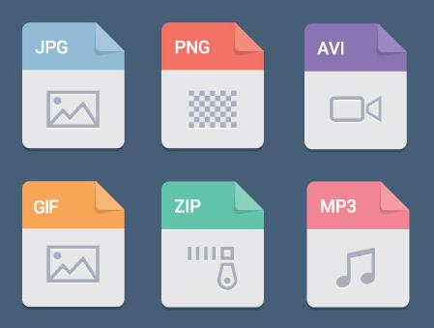
File formats
What are five compressed file formats used for images, sound, video or documents?
Which are lossy and which are lossless?

Slide 20
Common file standards
File format | Type of compression | File usage
JPEG | Lossy | Photos
PNG | Lossless | Images/photos, may include transparency
ZIP | Lossless | Document compression
GIF | Lossless | Simple images, may include animation
MP4 | Lossy | Video file format
MP3 | Lossy | Music format
FLAC / ALAC | Lossless | Lossless Music format (Free / Apple)

Slide 21
Worksheet 7
Complete Task 3 and Task 4 on Worksheet 7

Slide 22

Plenary
With a partner, take it in turns to explain the following:
Data compression
Run length encoding (RLE)
Lossy compression
Lossless compression

Slide 23
Plenary
Data compression
Reducing the amount of bits required to represent data
Used to reduce the amount of storage space to store data or the amount of data that needs to be transmitted
Run length encoding (RLE)
An algorithm to compress data that uses frequency/word pairs to reduce the amount of data stored – e.g. 1 for white, 0 for black so that 5 1 3 0 represents five 1s and three 0s
Lossy and lossless compression
Lossy compression will permanently lose information from the image/sound file; lossless compression will not

